Slide 1
Automated CCTV Monitoring (Image Captioning )
Infosys Spring Board Internship Project
Presented By :
Sourav Maji

Slide 2
Contents
Problem Statement and Business Use Cases
Introduction to image captioning and Business use cases
About Dataset and Data Preprocessing
Overview of given dataset and techniques on Text and Image preprocessing
Model Building Approach
Overview of model building process
Model Used
Discussion on various model which are used in this project
Result Analysis and Future Scope
Analysis the output and discussion on future scope

Slide 3
Problem Statement and Business Use Cases
Image Captioning
generating descriptive textual content from visual data.
enabling machines to interpret and explain images.
Problem Statement
Human Limitations
Scalability Issues
Delayed Response
High Volume of Surveillance Data

Slide 4

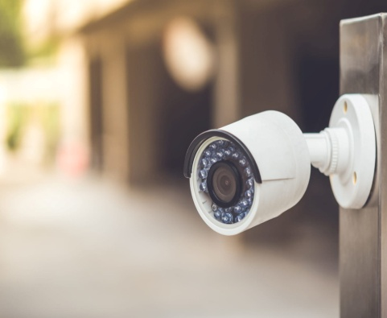

Problem Statement and Business Use Cases Cont’d..
Business Use Cases
Automated CCTV monitoring enhances business security and operational efficiency by providing real-time surveillance, reducing labor costs.
Real-Time Monitoring
Cost Efficiency
Enhanced Security

Slide 5
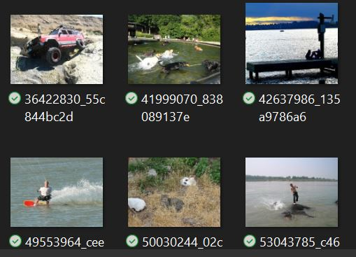
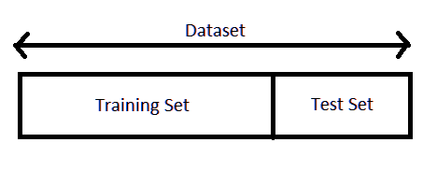
About Dataset and Data Preprocessing
Overview of Dataset
Data set contains various images and their respective captions.
Images
Memory usage up to 1 GB with 8091 images
Main features as images and their respective captions
Train data 90 % and Test data 10 %

Slide 6
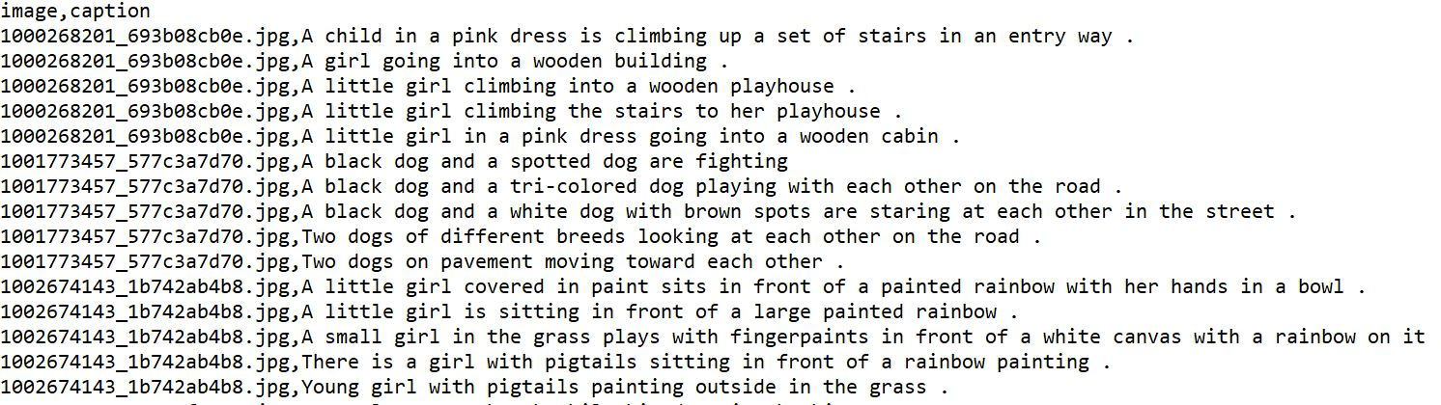
About Dataset and Data Preprocessing Cont’d…
Captions

Slide 7




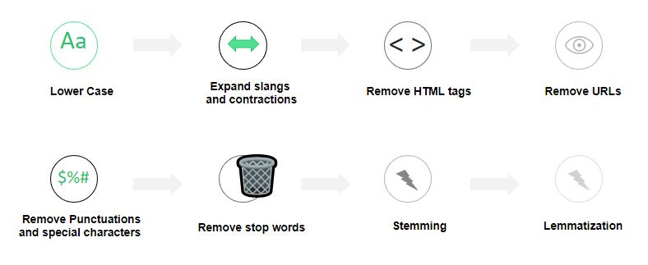
About Dataset and Data Preprocessing Cont’d…
Image Preprocessing
Cleaning the images is essential for building any models and also essential for proper caption generation.
Remove Background from Images
Remove noise from Images
Resize Images
Scaling of Images
Text Preprocessing
Preprocessing the text is essential for building any models and also essential for proper caption generation.

Slide 8

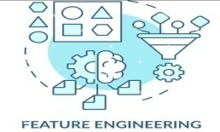
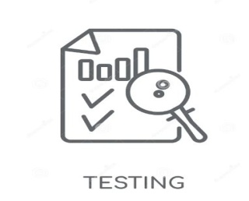


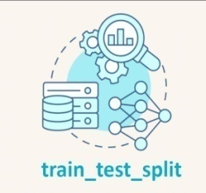
Model Building Approach
Data Preprocessing
Preprocess the images and text for building better model.
Feature Engineering
Extract the features from the images for better model building by using VGG16 pre trained model and store the features into pickle file.
Mapping of Image to Captions
create mapping of image to captions
Result Analysis
Analysis the result by BLUE SCORE metric and visualize the result by Matplotlib .
Model Training
Train the model by 90% train dataset and save the model .
Model Creation
Creating a model to generate a perfect caption a picture
Splitting the dataset
Splitting the entire dataset into train and test dataset. Took 90% of train data and 10% test data.
Model Building Work Flow

Slide 9
Model Used
VGG16 Model
CNN+LSTM Model
Used VGG16 pre-trained model for features extraction from the images, which are basically used for better model building .
Used CNN+LSTM for model building.

Slide 10
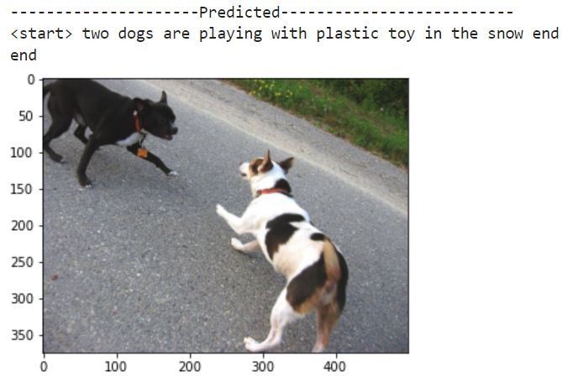
Result Analysis
Model Result
BLUE – 1 Score : 0.155453
BLEU-2 Score : 0.086419
Result Visualization

Slide 11
Future Scope
Improved Data Management:
Utilizing cloud services for better storage, retrieval, and analysis of vast amounts of video data.
Increased Automation:
Systems that not only detect threats but also trigger automated responses such as alerts, lockdowns, or law enforcement notifications.
User-friendly Interfaces and Accessibility:
More intuitive interfaces for easier monitoring and management by security personnel.
Remote access and control through mobile applications, allowing for real-time monitoring from anywhere.

Slide 12
THANK YOU
Thank you Infosys Springboard for the wonderful opportunity
to show case our work!

